Slide 1
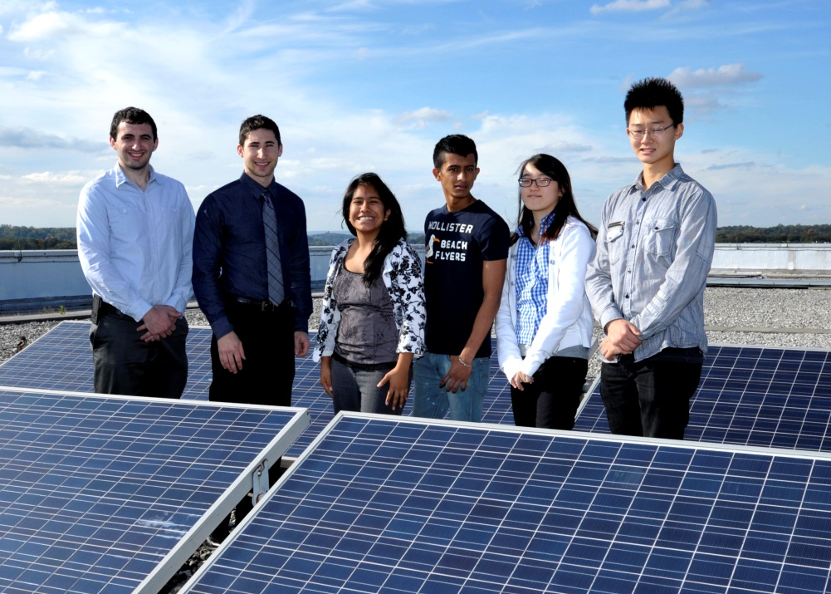
NYPA Internship Presentation
By: Javier Chablal, Janet Cortes,
Sun Kim, Joyce Shin

Slide 2


Program Background
Solar One received a grant from the Rockefeller Foundation to establish a program for NYC High School students
Solar One asked The New York Power Authority, NYPA, to help
NYPA gladly accepted this opportunity and took four (4) Students

Slide 3
Purpose of Internship
Provide us with:
Job experience on “green careers”
hands on experience in engineering
Life lessons
Work with engineers

Slide 4
Overview of Internship
Learned typical building systems
Reviewed designs/audit reports
Analyzed energy sources
Performed our own audit report for Bayside High School

Slide 5
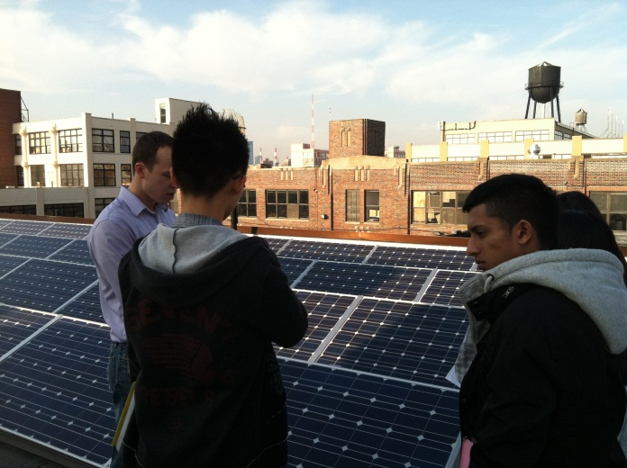
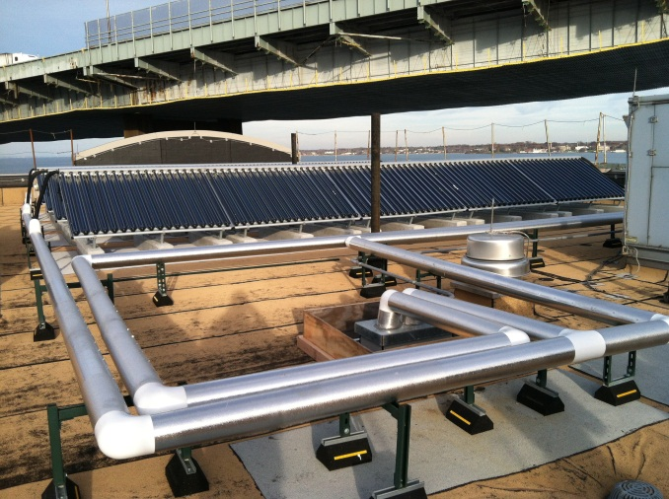
Sites visited
Projects in Design
PS238Q and PS21Q
Projects in Construction
SUNY Maritime
Completed Projects
FDNY Fleet Services, Bayside HS
NYPA WPO
FDNY: Fleet Services
SUNY Maritime

Slide 6
Experience at Bayside HS
Went to Mechanical Areas
Boilers, HVAC systems, DHW tanks
Conducted Lighting walk-through
Room 215

Slide 7
Bayside HS Audit
ECM’s
Steam Traps
Thermostats
Window A/C optimization
Lighting
Sensor Installation
Premium Motors

Slide 8
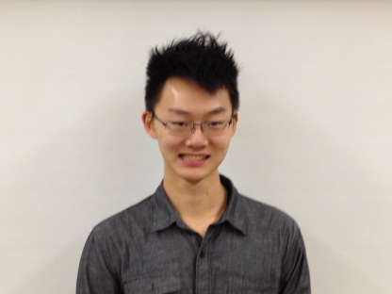
Sun Kim
Learned how boiler systems, lighting inspections, and solar panels work
Organization skills improved
Able to use newly acquired skills and apply them to real life scenarios
My favorite part was observing all the different types of solar panels

Slide 9
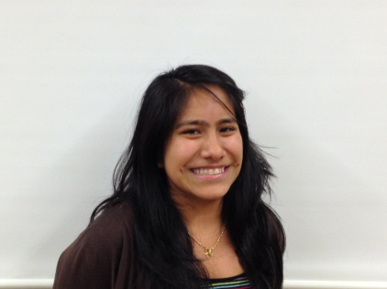
Janet Cortes
Learned:
How to conduct an energy audit
Decision-making skills
Communication skills
Professionalism
To make the experience better, the internship should be longer
My favorite part was learning new information that I previously did not know

Slide 10
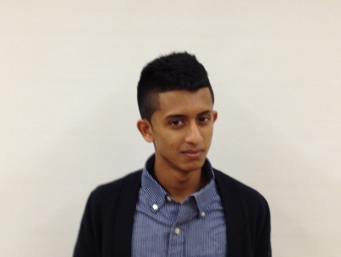
Javier Chablal
Learned a lot about the engineering world and industry
Learned the importance of energy efficiency and how to read engineering schematics
To make this experience better, I would have liked it to start earlier, perhaps in summer
My favorite part was the trip to SUNY Maritime

Slide 11
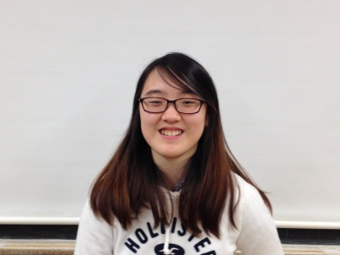
Joyce Shin
Learned how to write audit reports
Solidified passion for Electrical Engineering
My favorite part was getting paid for something I enjoy doing

Slide 12
Summary
The Internship with NYPA was definitely a life changing experience. It gave us interns a great head start into the world of engineering, and changed our attitudes, sleeping patterns, but most importantly affirmed our decision on pursuing an engineering career

Slide 13


